Slide 1
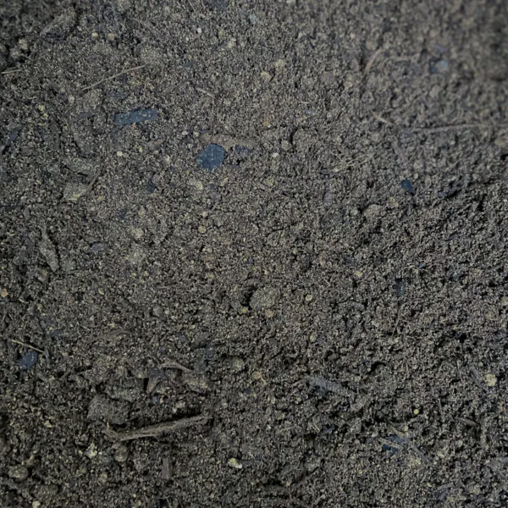
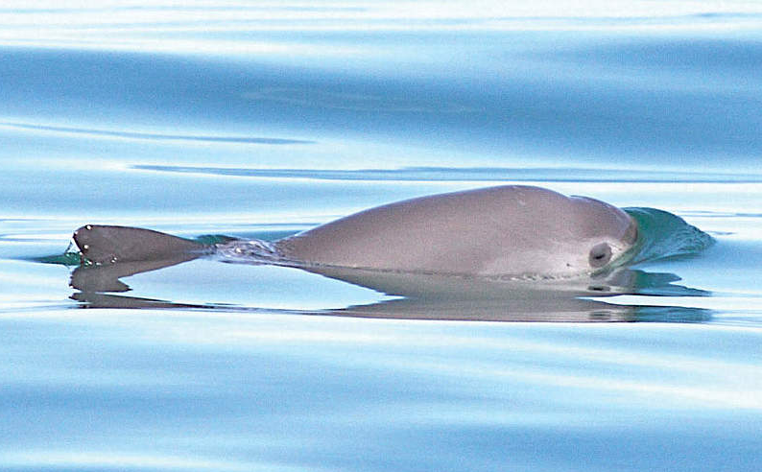
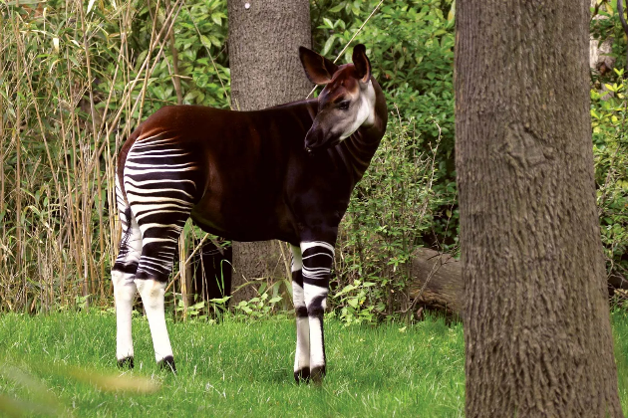
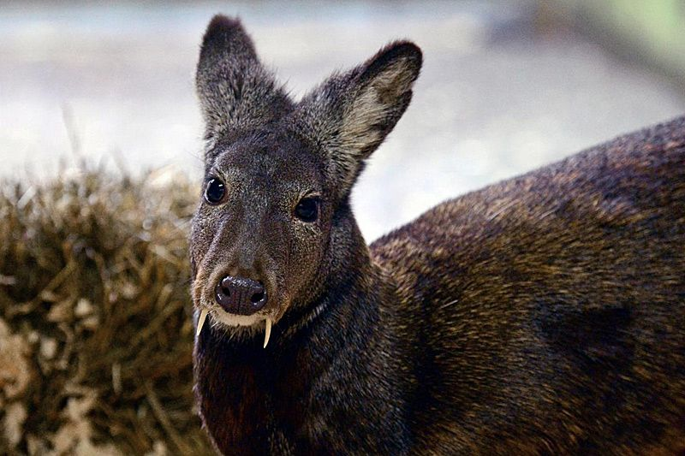
Talking about the future of vaquitas, okapis, and musk deer
The discursive construction of time and temporalities in connection with the IUCN labels ‘critically endangered’, ‘endangered’ and ‘vulnerable’
Georg Marko
English Department, Uni Graz
Notes:
Background soil photo: https://livingearth.net/product/soil-with-compost/
Okapi front page © IMPALASTOCK/iStock/Getty Images Plus
Vaquita front page © Thomas A. Jefferson / VIVA Vaquita
Moschustier front page (Photo Julie Larsen Maher © WCS)
Other pictures:
https://de.wikipedia.org/wiki/Kalifornischer_Schweinswal#/media/Datei:Phocoena_sinus.jpg
https://www.zoo-leipzig.de/tier/okapi/
https://www.derstandard.at/story/2000007647562/hirsch-mit-draculazaehnen-nach-66-jahren-wieder-gesichtet (Photo Julie Larsen Maher © WCS)
https://www.mdr.de/tv/programm/sendung-763810.html

Slide 2
http://georgmarko.com

Slide 3
This is about…
… our perspective on endangered animals and the risk of extinction and thus about the future of biodiversity, as constructed in and through language use.

Slide 4
  Its [Lord Howe island stick-insect] continued survival is far from secure. The population is exceptionally small, has an extremely restricted distribution and occupies habitat that appears to be suboptimal. Consequently, the species faces a very high risk of extinction through random stochastic events. Now that the existence and exact location of the population are known, the species is also a potential target for illegal poaching by unscrupulous insect collectors. […] The habitat occupied by D. [Dryococelus] australis is extremely fragile and unstable, consequently any disturbance may have catastrophic consequences for the species.
They’re anticipating that our feathery friends are going to have a pretty decent breeding season this summer and preparation has been in full swing. The team’s been busy planning for this breeding season since 2016 with regular health checks for the birds and collecting data, and now it’s all systems go.

Slide 5
  Its [Lord Howe island stick-insect] continued survival is far from secure. The population is exceptionally small, has an extremely restricted distribution and occupies habitat that appears to be suboptimal. Consequently, the species faces a very high risk of extinction through random stochastic events. Now that the existence and exact location of the population are known, the species is also a potential target for illegal poaching by unscrupulous insect collectors. […] The habitat occupied by D. [Dryococelus] australis is extremely fragile and unstable, consequently any disturbance may have catastrophic consequences for the species.
They’re anticipating that our feathery friends are going to have a pretty decent breeding season this summer and preparation has been in full swing. The team’s been busy planning for this breeding season since 2016 with regular health checks for the birds and collecting data, and now it’s all systems go.
Notes:
Vaquita background https://de.wikipedia.org/wiki/Kalifornischer_Schweinswal#/media/Datei:Phocoena_sinus.jpg (Alfokrads - Eigenes Werk)
Okapi background © Marcel Schauer/stock.adobe.com https://www.zoo-leipzig.de/tier/okapi/
Moschustier background https://www.mdr.de/tv/programm/sendung-763810.html

Slide 6
  Its [Lord Howe island stick-insect] continued survival is far from secure. The population is exceptionally small, has an extremely restricted distribution and occupies habitat that appears to be suboptimal. Consequently, the species faces a very high risk of extinction through random stochastic events. Now that the existence and exact location of the population are known, the species is also a potential target for illegal poaching by unscrupulous insect collectors. […] The habitat occupied by D. [Dryococelus] australis is extremely fragile and unstable, consequently any disturbance may have catastrophic consequences for the species.
They’re anticipating that our feathery friends are going to have a pretty decent breeding season this summer and preparation has been in full swing. The team’s been busy planning for this breeding season since 2016 with regular health checks for the birds and collecting data, and now it’s all systems go.

Slide 7
  Its [Lord Howe island stick-insect] continued survival is far from secure. The population is exceptionally small, has an extremely restricted distribution and occupies habitat that appears to be suboptimal. Consequently, the species faces a very high risk of extinction through random stochastic events. Now that the existence and exact location of the population are known, the species is also a potential target for illegal poaching by unscrupulous insect collectors. […] The habitat occupied by D. [Dryococelus] australis is extremely fragile and unstable, consequently any disturbance may have catastrophic consequences for the species.
They’re anticipating that our feathery friends are going to have a pretty decent breeding season this summer and preparation has been in full swing. The team’s been busy planning for this breeding season since 2016 with regular health checks for the birds and collecting data, and now it’s all systems go.

Slide 8
Biodiversity
In the sense of species diversity:
  “[…] the distribution and abundance of plant and animal species within an ecostystem.”
  (Pawan U. Gajbe (2020). Introduction to Biodiversity and its Conservation)
In the sense of global biodiversity:
  As large a number of different species as possible globally, each represented by an adequately (with respect to ecosystems) large number of individuals.
Notes:
There should be many and they should be well represented quantitatively.

Slide 9
Biodiversity is valuable
Functional value
  for humans
    (food security, natural product quality, air and water quality, etc.)
  for ecosystems
Ethical value
  Human-caused loss of biodiversity is an ethical failure, so conservation is a moral imperative.
Aesthetic value
  Experiencing a biodiverse world is pleasurable.

Slide 10
(Human-caused) Threats to biodiversity
Habitat loss
  (esp.deforestation)
Overexploitation
  (overhunting, overfishing, over-harvesting)
Intensive agriculture
  (pesticides, monoculture)
Invasive species
Environmental pollution
Climate change

Slide 11
Biodiversity and the future
Maintaining, protecting and enhancing biodiversity requires human intervention and management.
Active intervention
  Actively doing certain things.
Passive intervention
  Stopping doing certain things.

Slide 12
Conservation of biodiversity
In-situ conservation
  National parks & sanctuaries
Ex-situ conservation
  Zoos and botanical gardens
  Breeding programmes, seed banks, gene banks
Indirect conservation
  Laws and regulations protecting biodiversity
  Cultural changes
  Education

Slide 13
IUCN
= International Union for the Conservation of Nature
Founded in 1948.
Union of approx. 1,400 government and civil organizations (incl. state agencies, NGOs, local and regional groups).
Main objective
  “to advance sustainable development and create a just world that values and conserves nature.”
  (IUCN homepage)

Slide 14
IUCN
Method
  “Data, analysis, convening and action.”
  (IUCN homepage)
Scientific perspective
  “A sound scientific basis is vital for effective nature conservation. This encompasses compiling data and assessing them against formal standards, providing access to information, publishing research, and interacting with peer scientific networks.”
  (IUCN homepage)

Slide 15

IUCN Red List
= Red List of Threatened Species
Lists the conservation status and extinction risks of species of plants and animals.
First version published in 1964.
It is based on regular assessment reports by special groups using strict scientific criteria.
It is a powerful tool to inform conservation action and policy.
Notes:
Icon https://www.iucn.org/ja/node/32539

Slide 16
IUCN Red List
= Main objective
  “[The Red List is an] indicator of the health of the world’s biodiversity.”
  “It is a powerful tool to inform conservation action and policy.”
  (IUCN homepage)
Notes:
Icon https://www.iucn.org/ja/node/32539

Slide 17
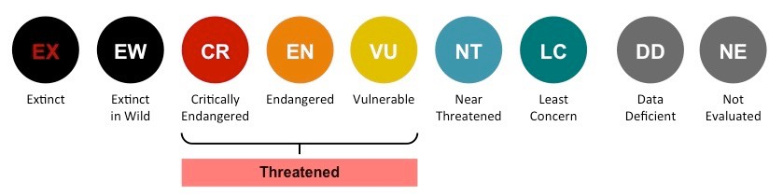
Categories of the Red List
Notes:
https://ib.bioninja.com.au/options/option-c-ecology-and-conser/c4-conservation-of-biodiver/endangered-species.html

Slide 18
Criteria
Population reduction
  Significant decrease in individuals in the last 10 years.
Geographical range
  Low number of different areas where the species occurs and extent of occurrence is small (in km²).
Population size
  Low number of mature individuals.

Slide 19
Criteria
Population reduction
  CR ≥ 90%, EN ≥ 70%, VU ≥ 50%
Geographical range
  CR < 100km2, EN < 5,000km2, VU < 20,000km2.
Population size
  CR < 250, EN < 2,500, VU < 10,000

Slide 20
Two perspectives on biodiversity
Optimism
  Emphasis on agency (human intervention), opportunities and positive outcomes, often (but not necessarily) in combination with a close relationship with and dedication to nature.
Pessimism
  Emphasis on problems and difficulties (of human intervention), risks and negative outcomes, often (but not necessarily) in combination with a distanced relationship to nature.

Slide 21
Research question
How (qualitative) and to what extent (quantitative) do optimism and pessimism play a role in the conceptualization of endangered species as constructed in texts on these species?
Are there differences in the conceptualizations of different levels of extinction risks (critically endangered, endangered, vulnerable)?

Slide 22
Method
Corpus-based discourse analysis (or CADS), with the help of Wordsmith Tools 8.

Slide 23
Corpus
Texts on animals included in the IUCN’s Red List of Threatened Species, with an equal number of texts for each of the three labels (CR, EN, VU).

Slide 24
Corpus selection criteria
Topics
  Choosing 10 animals for each label.
    5 mammals, 1 bird, 1 reptile, 1 amphibium, 1fish, 1 insect or other.
Registers & genres
  Finding and selecting 5 academic/scientific texts and 5 ‘popular’ texts targeting a lay audience.
    Academic/scientific texts: articles, book chapters, texts provided on university pages.
    ‘Popular’ texts: all kinds of genres, including news texts and blogs.
Numbers

Slide 25
Critically endangered
Endangered
Vulnerable
Vaquita
Borneo orangutan
Red wolf
Black rhinoceros
Chinese pangolin
Kākāpō
Gavial
Axolotl
Great hammerhead
Lord Howe Island Stick-insect
Okapi
Bonobo
Blue whale
Sea otter
Tasmanian devil
Secretary bird
Spotted turtle
Relict leopard frog
Huchen
Luzon Peacock Swallowtail
Musk deer
Slow loris
Dugong
Sun bear
Giant armadillo
Atlantic puffin
Burmese python
California tiger salamander
Sterlet
Wetapungo

Slide 26
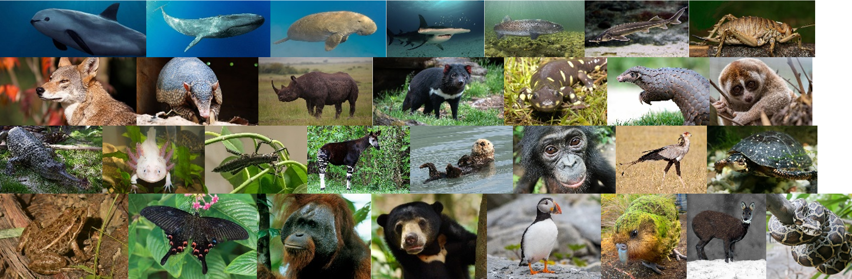

Slide 27
Problems
Unbalanced
  The texts differ quite dramatically in length (from 500-15,000 words).
‘Dirty’
  The selection process was not systematic, as the animals are not equally popular and thus do not feature in comparable numbers of texts.

Slide 28
Statistical information
Overall size: 714,180 word tokens
Number of texts: 300
Average length: 2,381 word tokens
Standardized TTR: 43.1

Slide 29
Statistical information (components)
Science corpus: 537,978 word tokens
Popular corpus: 176,202 word tokens
Critically endangered: 234,461 word tokens
Endangered: 260,710 word tokens
Vulnerably: 219,009 word tokens

Slide 30
Vaquita | 30,871 | Okapi | 22,492 | Musk Deer | 16,330
Bornean Orangutan | 36,613 | Blue Whale | 26,068 | Dugong | 25,968
Red Wolf | 28,444 | Bonobo | 25,324 | Giant Armadillo | 24,761
Black Rhino | 22,917 | Sea Otter | 33,176 | Sun Bear | 26,261
Chinese Pangolin | 18,203 | Tasmanian Devil | 24,915 | Slow Lori | 27,767
Kakapo | 20,443 | Secretary Bird | 27,885 | Atlantic Puffin | 20,102
Gavial | 17,282 | Spotted Turtle | 36,127 | Burmese Python | 17,047
Axolotl | 20,260 | Leopard Frog | 22,550 | Tiger Salamander | 18,952
Hammerhead | 23,687 | Huchen | 19,332 | Sterlet | 25,449
Stick-insect | 15,741 | Swallowtail | 22,841 | Wetapunga | 16,372

Slide 31
Annotation
The corpus has been
  structurally annotated
  (tables, figures, references, peritext);
  tagged for parts-of-speech and semantic categories.

Slide 32
Semantic profiling
Establishing which areas of meaning are salient in a discourse, based on words and their meanings and the quantitative relations between the semantic categories to which they can be assigned.
Quantification draws upon token numbers, i.e. on how often words in a category occur.
(Semantic profiles are here based on the 250 most frequent content lexemes in the corpus.)
Notes:
Lemmatization and stoplisted.

Slide 33
Overall results
Category | Freq. | %
General activity & existence | 3,244 | 2.2%
Categorization & complexity | 9,858 | 6.8%
Causality & instrumentation | 5,415 | 3.7%
Space | 5,322 | 3.7%
Countries. nations. regions | 3,562 | 2.5%
Habitats | 6,340 | 4.4%
Time | 10,002 | 6.9%
Colours | 1,993 | 1.4%
Communication & media | 2,864 | 2.0%
Mind | 4,503 | 3.1%
Body | 1,791 | 1.2%
Nutrition | 3,442 | 2.4%
Reproduction | 8,024 | 5.5%
Pathology | 286 | 0.2%
Fauna | 20,930 | 14.5%
Flora | 892 | 0.6%
Humanity | 710 | 0.5%
Exploitation of nature | 1,146 | 0.8%
Conservation of nature | 3,461 | 2.4%
Scientific practice | 11,525 | 8.0%
Quantification | 22,353 | 15.4%
Evaluation | 5,404 | 3.7%
Others & undefined | 11,651 | 8.1%

Slide 34
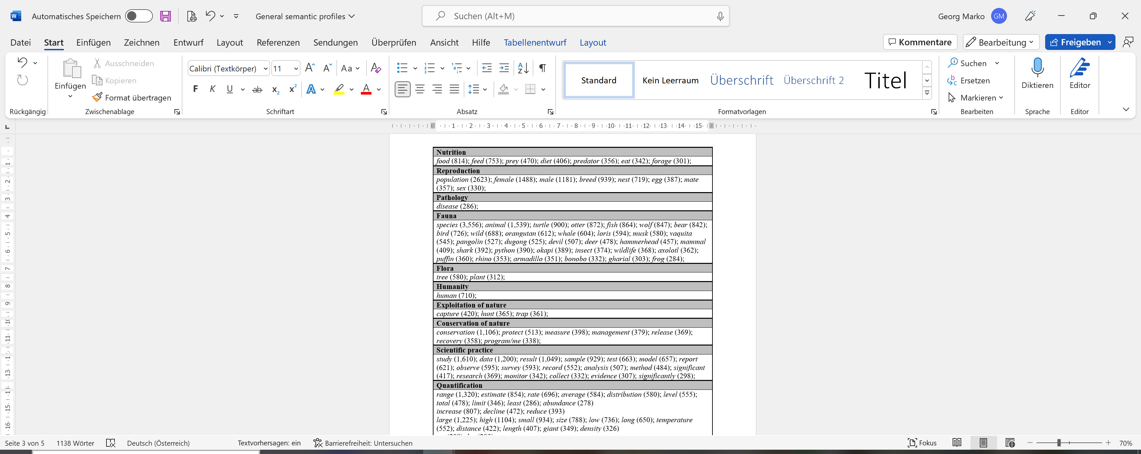

Slide 35
Overall results
Category | Freq. | %
General activity & existence | 3,244 | 2.2%
Categorization & complexity | 9,858 | 6.8%
Causality & instrumentation | 5,415 | 3.7%
Space | 5,322 | 3.7%
Countries. nations. regions | 3,562 | 2.5%
Habitats | 6,340 | 4.4%
Time | 10,002 | 6.9%
Colours | 1,993 | 1.4%
Communication & media | 2,864 | 2.0%
Mind | 4,503 | 3.1%
Body | 1,791 | 1.2%
Nutrition | 3,442 | 2.4%
Reproduction | 8,024 | 5.5%
Pathology | 286 | 0.2%
Fauna | 20,930 | 14.5%
Flora | 892 | 0.6%
Humanity | 710 | 0.5%
Exploitation of nature | 1,146 | 0.8%
Conservation of nature | 3,461 | 2.4%
Scientific practice | 11,525 | 8.0%
Quantification | 22,353 | 15.4%
Evaluation | 5,404 | 3.7%
Others & undefined | 11,651 | 8.1%

Slide 36
Comparative results
Category | CR |  | EN |  | VU
General activity & existence | 1,152 | 2.2% | 1,285 | 2.2% | 541 | 1.2%
Categorization & complexity | 3,280 | 6.4% | 4,056 | 6.9% | 2,867 | 6.1%
Causality & instrumentation | 1,767 | 3.4% | 2,041 | 3.5% | 1,406 | 3.0%
Space | 1,092 | 2.1% | 2,450 | 4.2% | 1,760 | 3.7%
Countries. nations. regions | 1,845 | 3.6% | 2,101 | 3.6% | 2,186 | 4.7%
Habitats | 1,381 | 2.7% | 3,868 | 6.6% | 1,869 | 4.0%
Time | 3,189 | 6.2% | 3,810 | 6.5% | 3,576 | 7.6%
Colours | 1,134 | 2.2% | 691 | 1.2% | 0 | 0.0%
Communication & media | 790 | 1.5% | 1,189 | 2.0% | 863 | 1.8%
Mind | 1,669 | 3.2% | 1,675 | 2.9% | 1,482 | 3.2%
Body | 603 | 1.2% | 550 | 0.9% | 1,058 | 2.3%
Nutrition | 692 | 1.3% | 1,236 | 2.1% | 1,122 | 2.4%
Reproduction | 3,009 | 5.8% | 3,267 | 5.6% | 2,277 | 4.8%
Pathology | 124 | 0.2% | 791 | 1.4% | 101 | 0.2%
Fauna | 7,860 | 15.3% | 8,682 | 14.9% | 7,936 | 16.9%
Flora | 702 | 1.4% | 265 | 0.5% | 347 | 0.7%
Humanity | 0 | 0.0% | 269 | 0.5% | 200 | 0.4%
Exploitation of nature | 1,176 | 2.3% | 139 | 0.2% | 652 | 1.4%
Conservation of nature | 1,470 | 2.9% | 1,338 | 2.3% | 988 | 2.1%
Scientific practice | 4,813 | 9.3% | 4,067 | 7.0% | 3,245 | 6.9%
Quantification | 6,662 | 12.9% | 8,557 | 14.7% | 7,477 | 15.9%
Evaluation | 2,132 | 4.1% | 2,221 | 3.8% | 976 | 2.1%
Others & undefined | 4,997 | 9.7% | 3,853 | 6.6% | 4,027 | 8.6%

Slide 37
Syntactic profiling
Establishing which syntactic functions are salient in a discourse with respect to particular items, based on constructions and the quantitative relations between the different categories to which they can be assigned.
Quantification draws upon token numbers.
Syntactic profiling in discourse analysis always tries to interpret the formal categories semantically, i.e. in terms of their contributions to meaning.

Slide 38
Syntactic profiling
(Syntactic profiling focuses on expression referring to the endangered animal species here.)

Slide 39
Syntactic profile: Categories
Subject
    Sun Bears have a toolbox of amazing adaptations that help them survive.
Object
    He also pleaded the public to stop keeping slow lorises as pets.
Prepositional phrase
    The current male bias among adult kākāpō may be a result of past differential mortality in the presence of introduced mammalian carnivores.

Slide 40
Syntactic profile: Categories
Ellipsis
  Headers, lists, parentheses
    […] population structure of the endangered marsupial Sarcophilus harrisii (Tasmanian devil)
Genitive
    The spotted turtle’s range overlaps that of many other turtles.
Compound
    pangolin conservation parameters

Slide 41
Syntactic profile: Categories
Other
  Complements, appositions, unclassifiable
    Two of four the female red wolves involved in these hybrid events were not 100% pure red wolves.
Foreign language
    The International Committee for the Recovery of the Vaquita (Comiti Internacional para la Recuperacisn de la Vaquita, or CIRVA) was established in 1996.

Slide 42
Results
Construction | Freq. | %
Subject NP | 4,175 | 36.8%
Object NP | 676 | 6.0%
PP | 3,576 | 31.5%
Ellipsis | 441 | 3.9%
Genitive NP | 220 | 1.9%
Compounds | 2,071 | 18.2%
Other | 188 | 1.7%
Foreign language | 5 | 0.0%
TOTAL | 11,352

Slide 43
Conclusions (“Really?”)
Certain semantic tendencies (e.g. strong focus on animals, scientific approach), but with the exception of perhaps the category of reproduction none that are concerned with the future (neither optimism, nor pessimism).
No obvious differences with respect to the three labels CR, EN, VU.
No clear syntactic trends.
Not more research, but more in-depth research is needed.

Slide 44
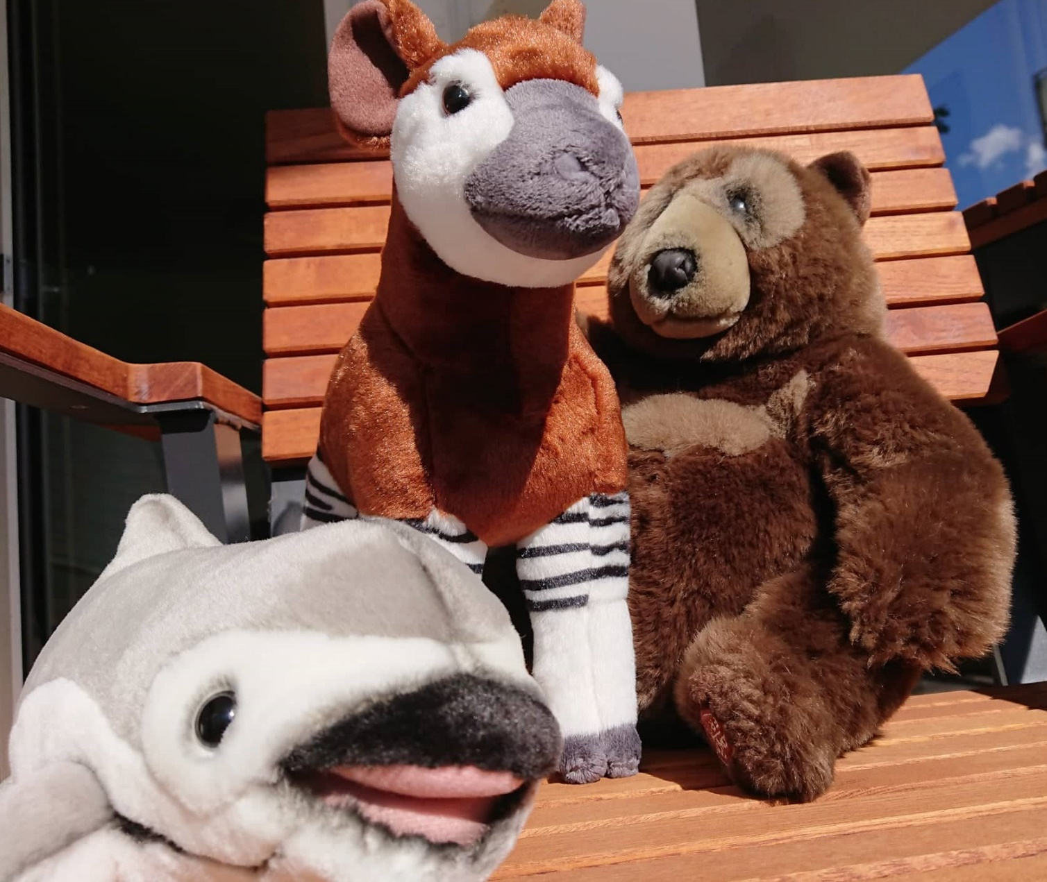
Thank you!

